Slide 1

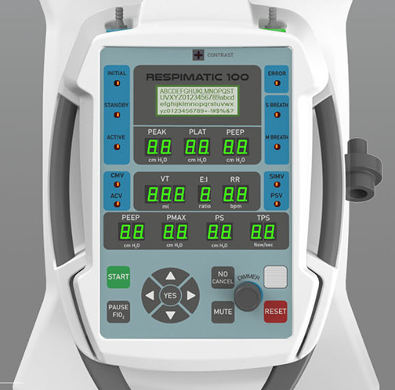
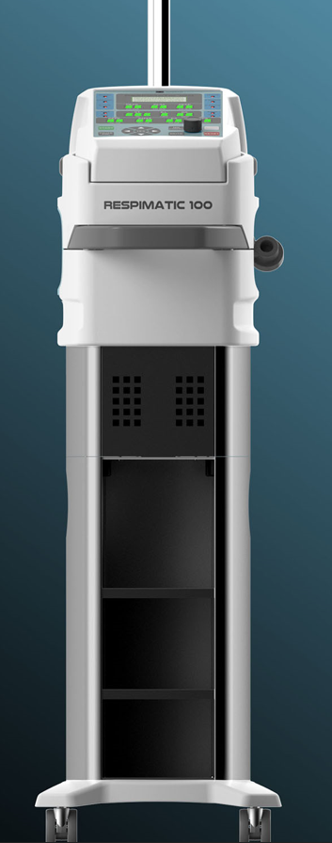
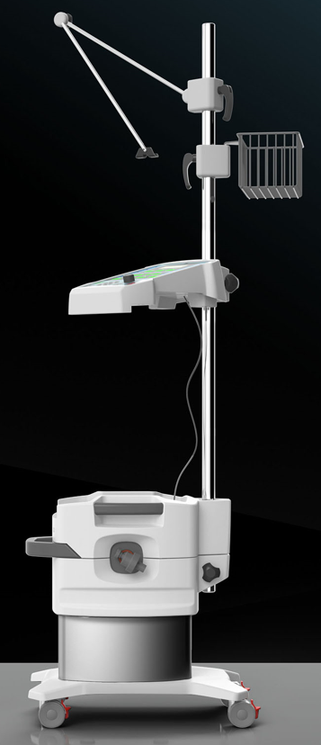

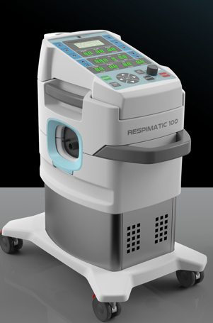

Respimatic 100
Sunil Nanda (PARC)

Slide 2
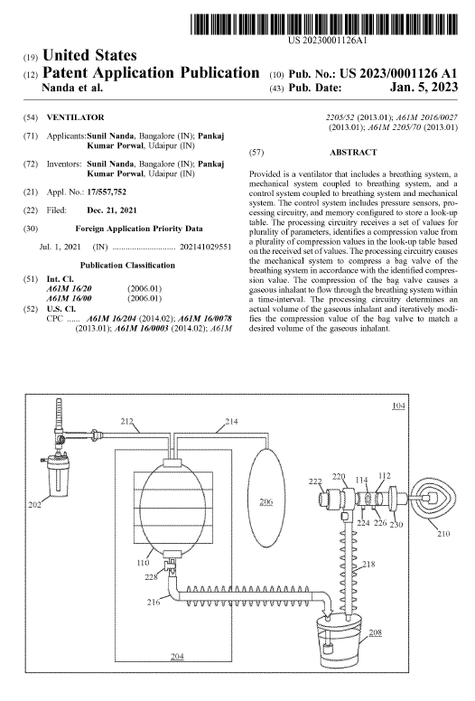
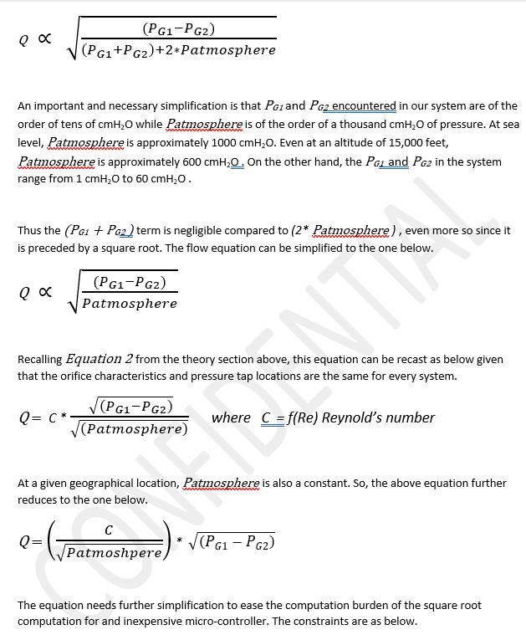
US and INDIA IP Protection
Patent Pending

Slide 3
Setting the Context
The Motivation
The Problem Statement

Slide 4

RESPIMATIC 100 (Patent Pending) Is it right for you?
Need adult, non-invasive respiratory support?
Support from Initiation to Weaning?
No compressed air or piped Oxygen?
Full range of Respiration parameters?
Remote monitoring capability?
Handle harsh-uncontrolled Environment?
Easy-to-use System?
Budget Friendly?
Connect to O₂ Cylinder or Concentrator?
Breath Synchronization for Patient Comfort?

Slide 5
The Motivation Serve the Bottom of the Pyramid
Medical Colleges & Specialization
(Tertiary In-patient Care)
Subdistrict Health Complex
(Out-patient & In-patient Care)
Village PHC
(Out-patient Care & Referrals)
District Hospitals
(Secondary In-patient Care)
Gram Panchayat PHC
(Ambulance, Emergency, Clinic)
A robust, portable respiration support system for remote Primary Health Centers in India and other developing countries.
A system that works in a harsh uncontrolled environment and as a travel ventilator without piped compressed air or piped oxygen.
A system that requires minimum training.
Fits budget of the bottom of the pyramid.

Slide 6

2 BIG Challenges
Lack of Affordability leading to Scarcity
Lack of Skilled Practitioners

Slide 7
Observations on Ventilator Evolution
Iron Lung Age
Pneumatic Age
µController Age
Smart “E”-Age
Most-used Ventilation Modes have not changed
Monitor pressures and flow
Safety Alarm systems
Volume and Pressure Control
Control BPM, I/E, VT and PS
Diminishing Returns from what has evolved …
Exotic Ventilation modes
Fancy Touch-screen LCD Displays
Multitude of Sensors

Slide 8

Respimatic – Respiratory Technology Revisited
Remote Diagnosis and Monitoring (Telemedicine)
Leverage Time-proven Technologies
Simplify Human-Machine Interface
Simplify design and feature list
Use Off-the-shelf proven components
Maintenance Breaths in case of unexpected errors
System must never stop delivering breaths.
Implement Fallback mechanism for each error scenario.
Rural, remote areas do not have skilled specialists
BUT Communication Technologies have come of age

Slide 9
Respimatic 100 Details
System Components
Technical Details

Slide 10
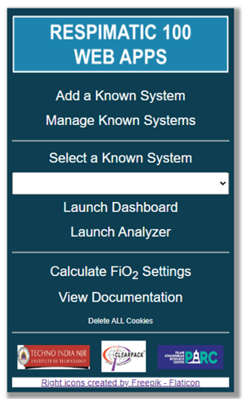
Our Solution RESPIMATIC 100
Complete set of WEB Apps
Remote Dashboard
Remote Recorder
Remote Analyzer
FiO₂ Calculator
Low-speed Wi-Fi sufficient
Phone Hot-spot sufficient
Uses secure HTTPS protocol
Field upgradable with new Firmware releases
4 Commonly Used Ventilation Modes
CMV, ACV, SIMV, PSV
Respiration Rate, Tidal Volume, PEEP, Pressure Support & FiO2 Controls
Volume Controlled and Pressure Supported Breaths
Mandatory & Spontaneous Breaths with Full Breath Synchronization
https://www.respimatic.com

Slide 11
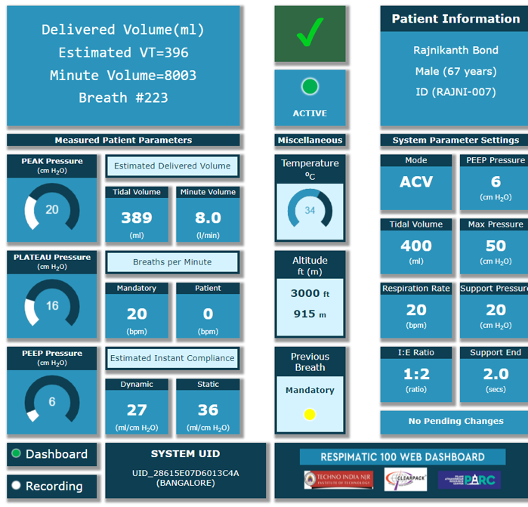
Dashboard Snapshot View
Anyone, anywhere in the world can monitor any patient via the WEB
Multiple specialists can monitor same patient
One specialist can monitor multiple patients
5 Dashboard views
Snapshots
Charts
Statistics
Breath Shapes
Alerts
https://www.respimatic.com

Slide 12
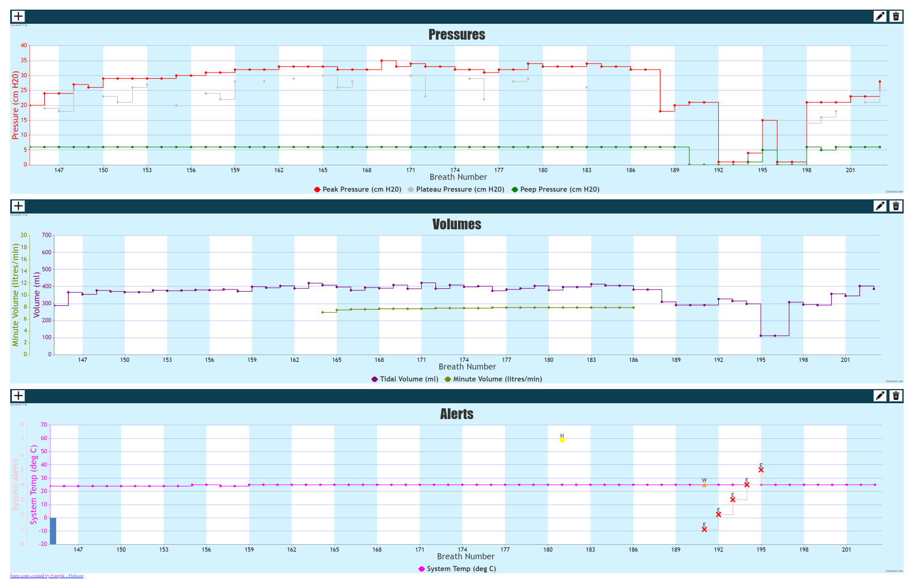
Dashboard Charts View

Slide 13
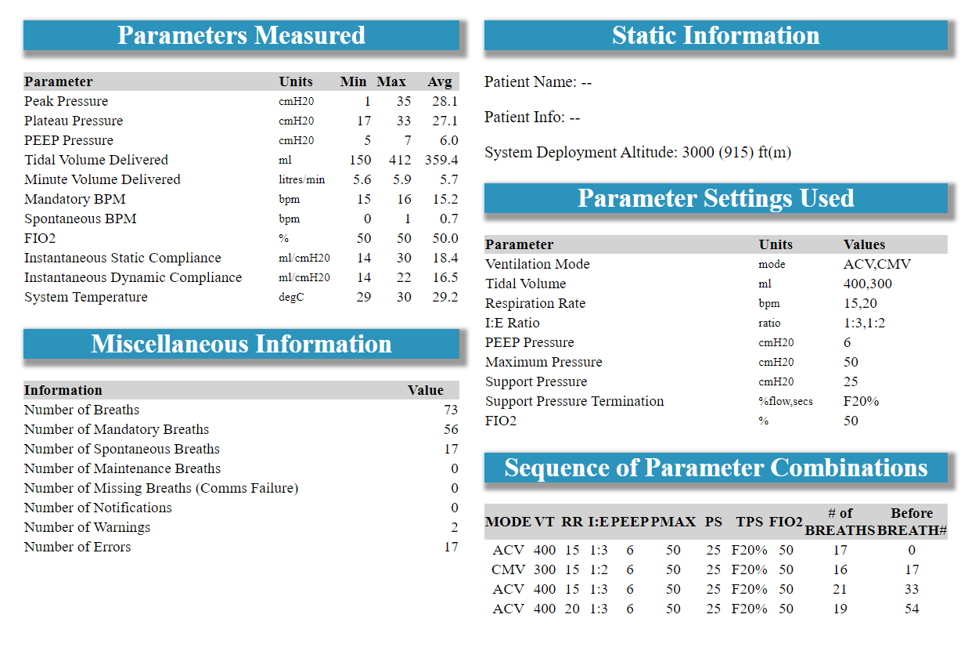
Dashboard Statistics View

Slide 14
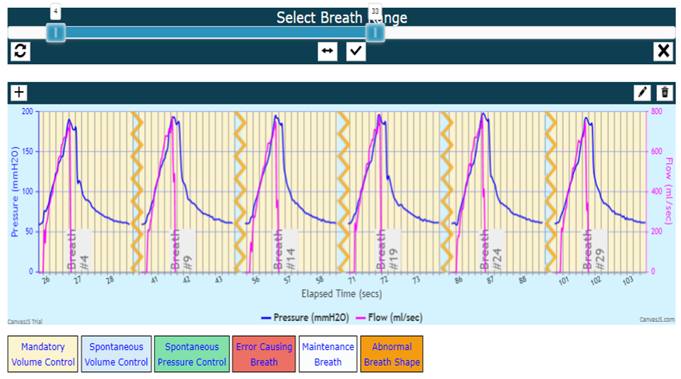
Dashboard
Waveforms View
Pressure and Flow Graphs
For Selected Breaths
Periodic Display
Display on demand

Slide 15
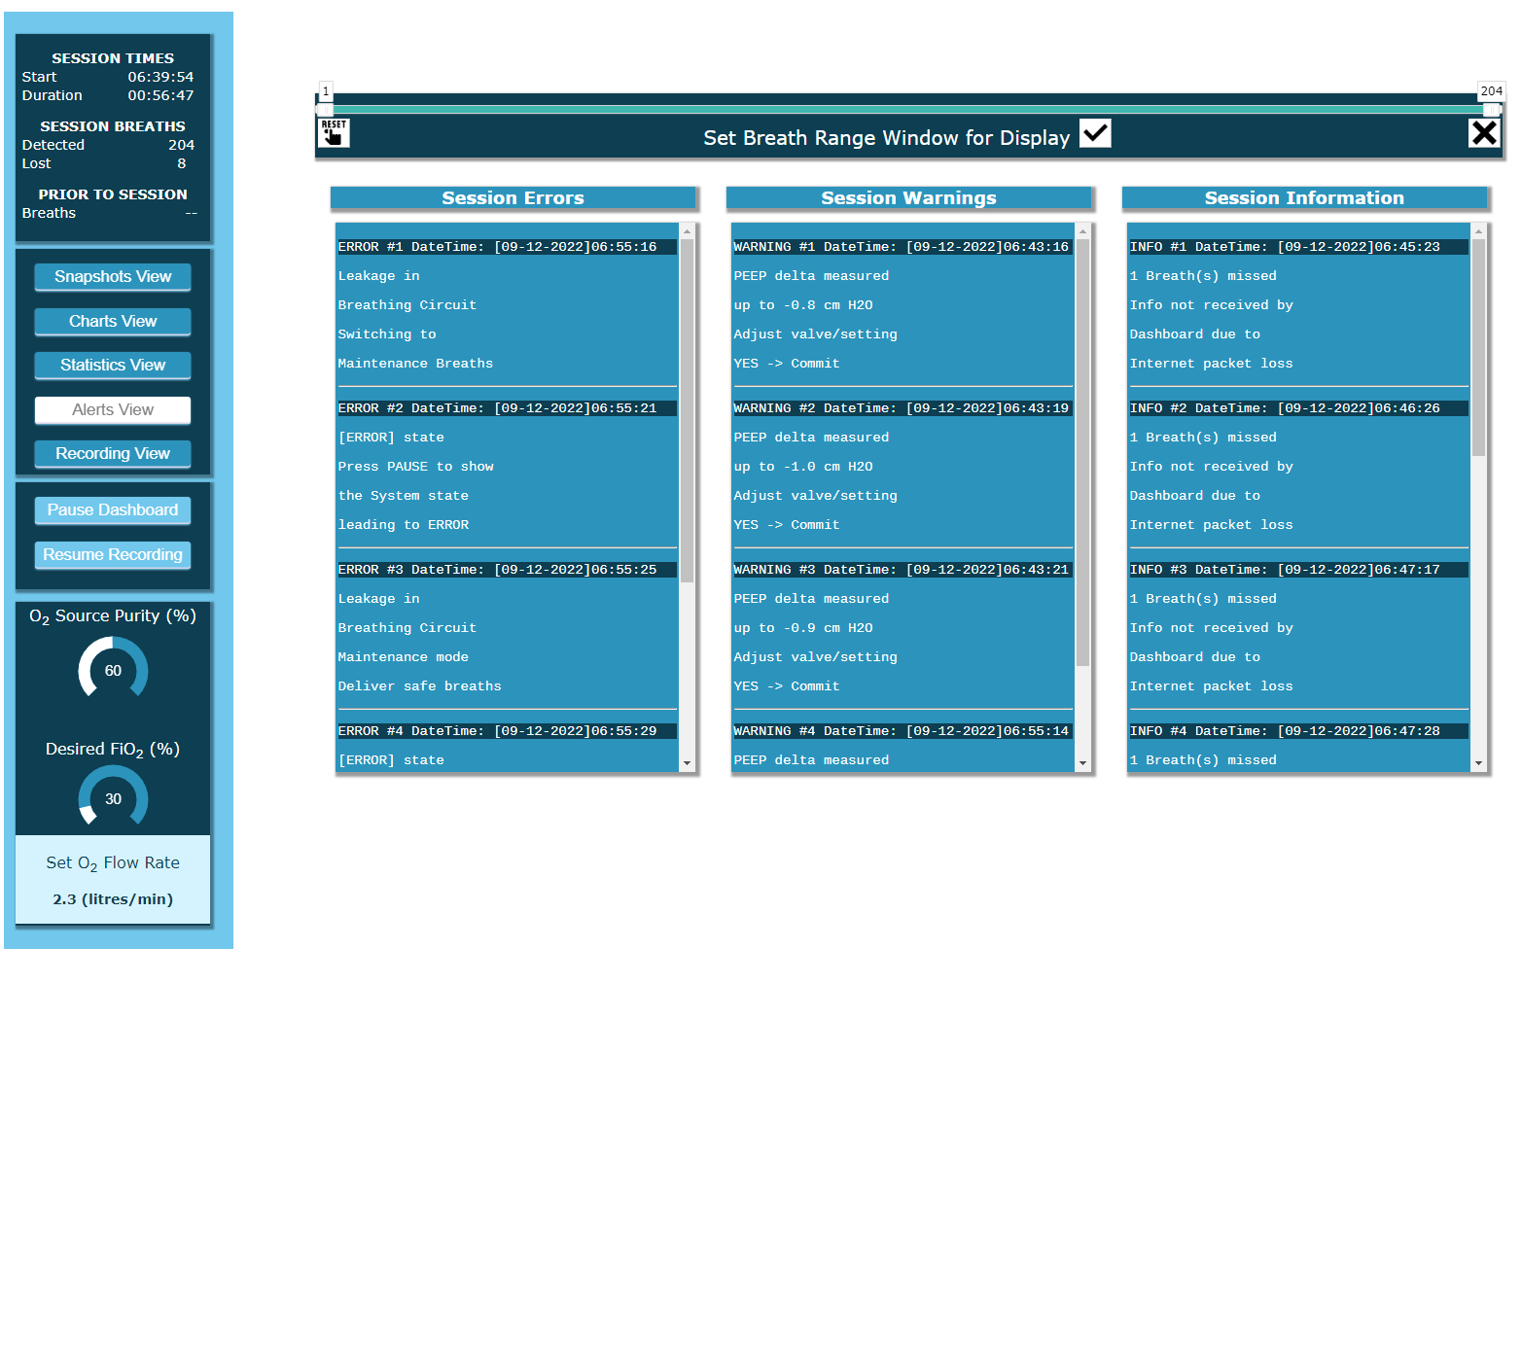
Dashboard Alerts View

Slide 16
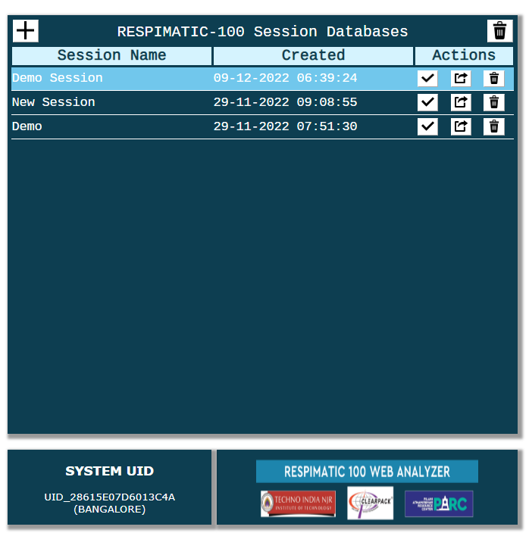
Analyzer
Any patient Session can be recorded locally or remotely.
The recorded Session can then be analyzed off-line using the Analyzer.

Slide 17
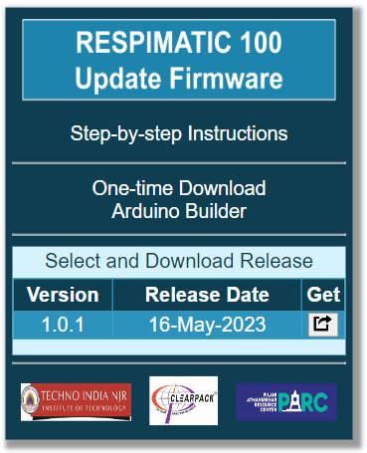
Updating Firmware
Firmware releases available on the WEB.
Step-by-step menu driven update procedure

Slide 18
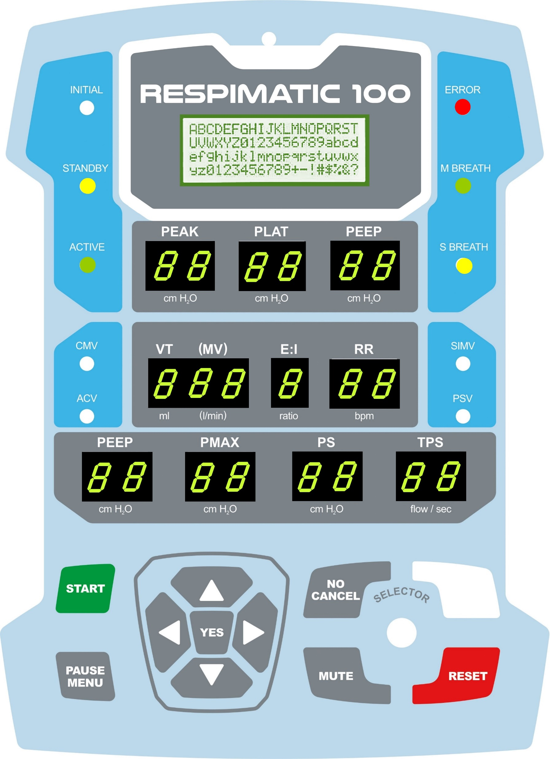
Front Panel The Human-Machine Interface
Simple Tactile buttons No delicate touch screen etc.
Easy to read 7-seg LED Parameters Display
Parameter selection using simple arrow buttons
4-line LCD Display for displaying Messages and Menus
Peak, Plateau, PEEP pressures displayed after each breath
Also shows Delivered Volumes, Lung Compliance, Breath types etc.

Slide 19
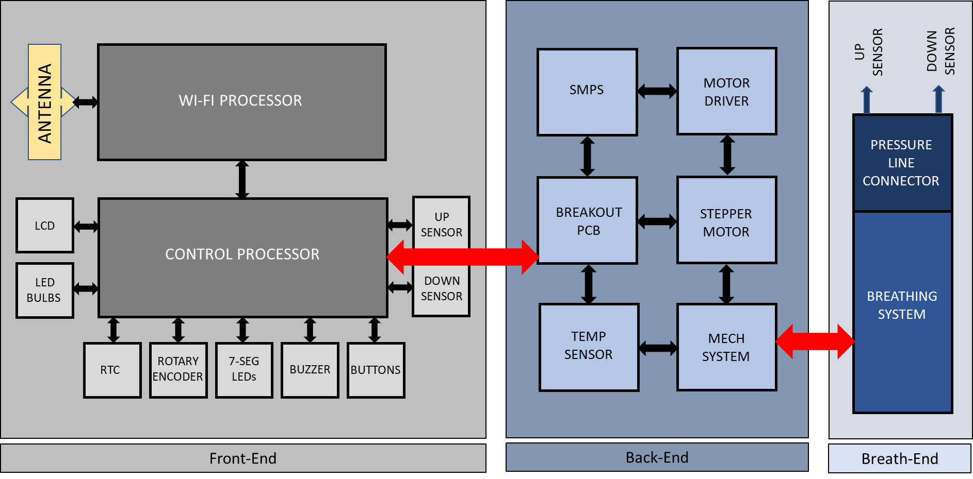
System Architecture
Clearly separated Frontend, Backend and Breathing system
IP is the Frontend design and Algorithms
Backend and Breathing System can have multiple avatars

Slide 20
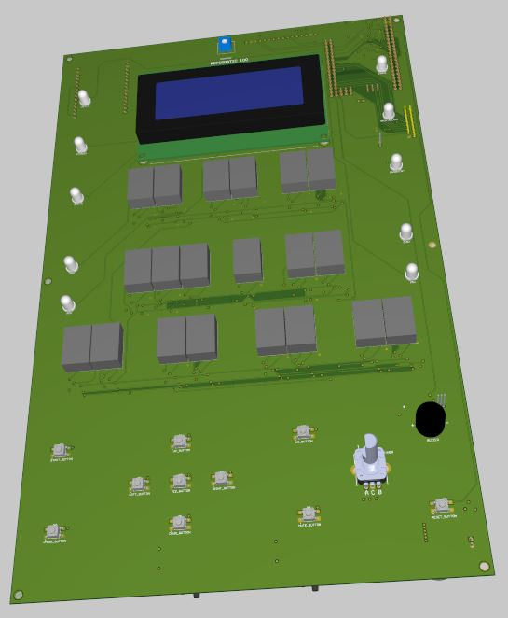
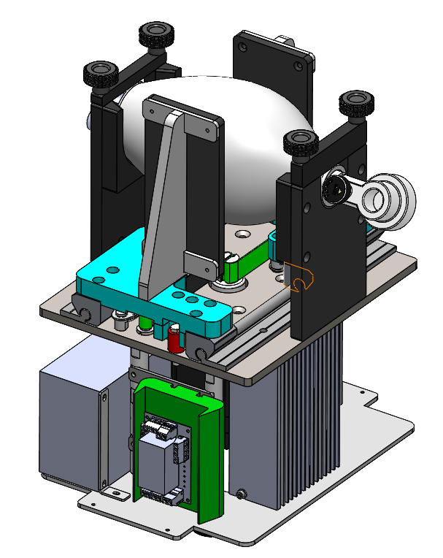
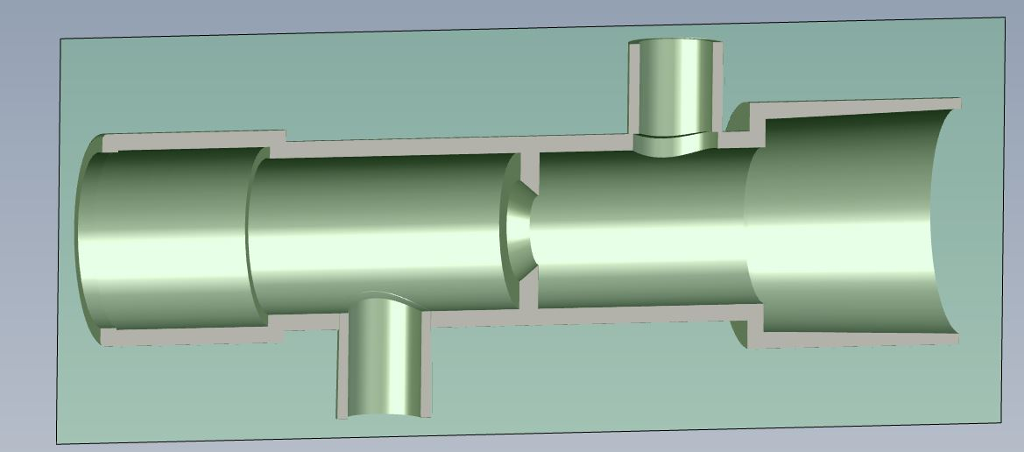
Respimatic 100
Under the hood
Low Production Cost
Compact and Robust
Intuitive HMI
Simple to operate
Simple Electronics COTS components
Rugged mechanical system
Complete Parameter monitoring
Complete set of alarm conditions
Robust, Suitable for mass production

Slide 21
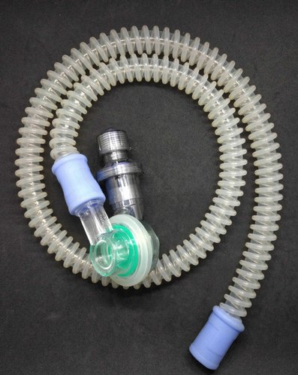
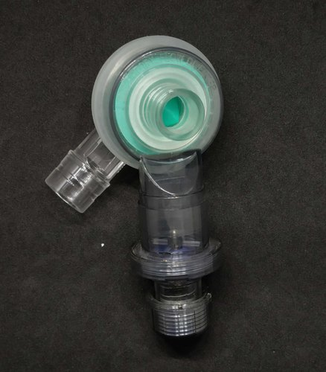
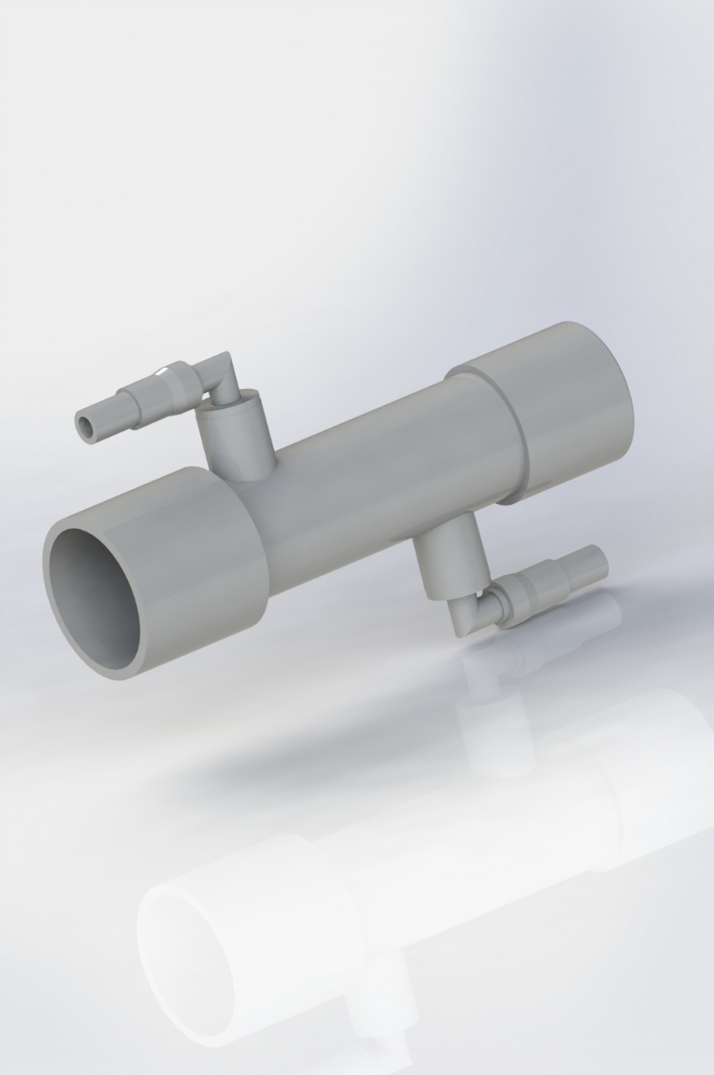
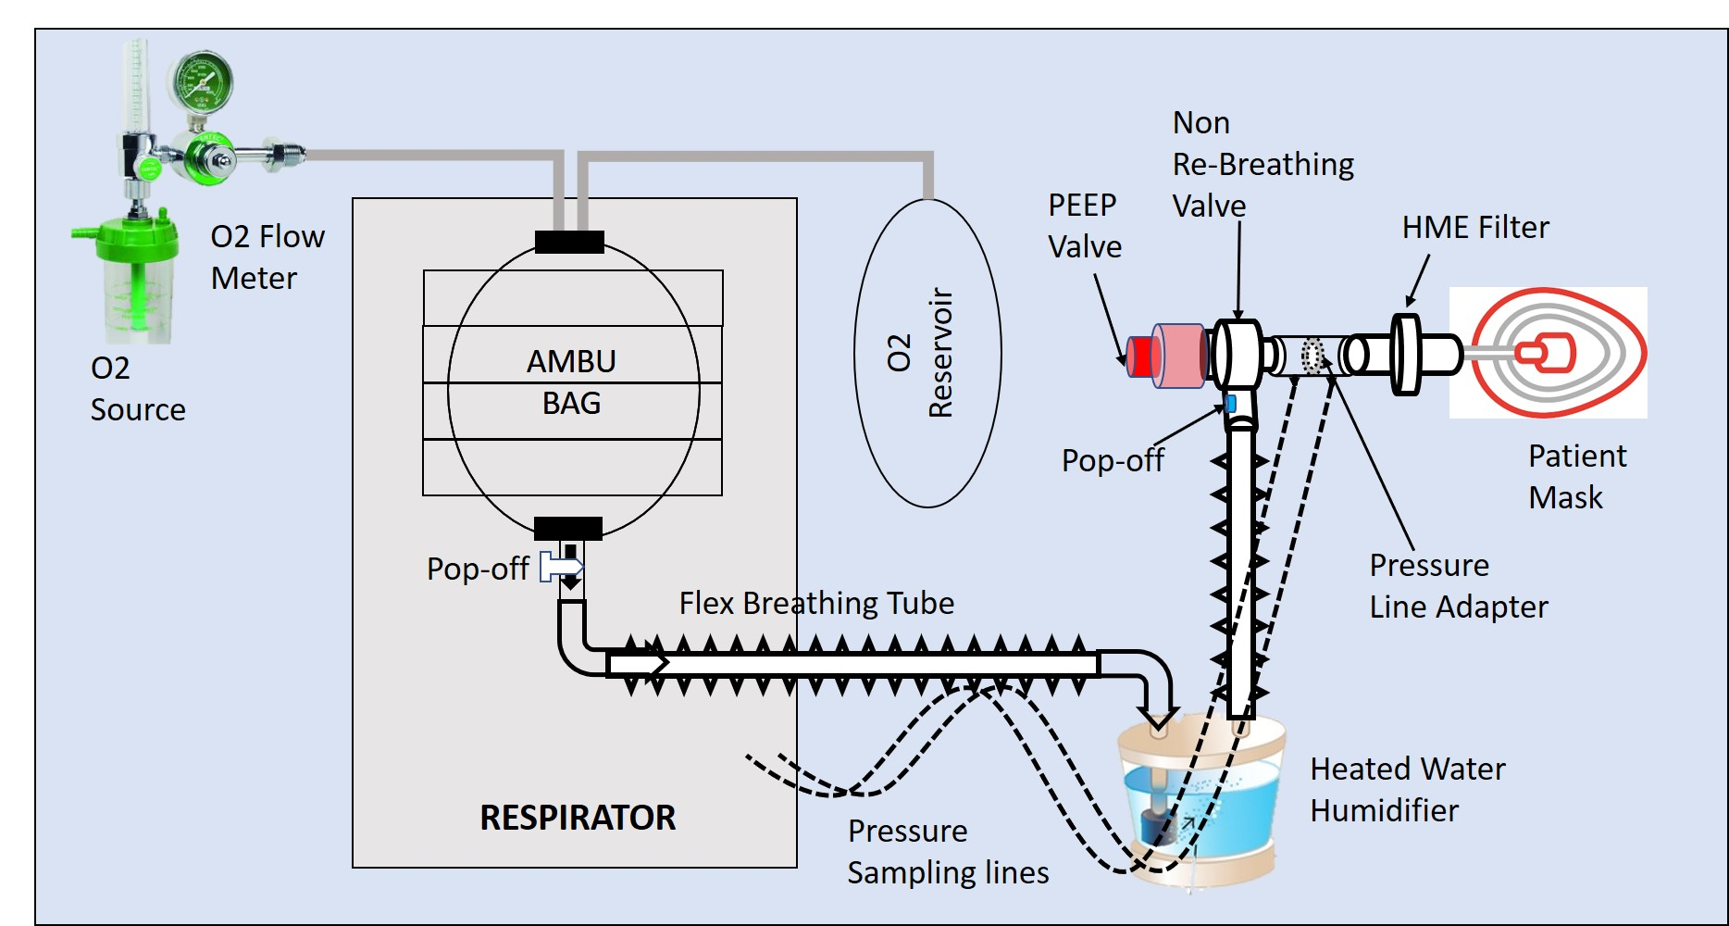
Breathing Circuit
Proprietary, patent-pending Pressure line connector with Orifice plate
COTS single-limb Breathing Circuit with NRBM
BVM or Ambu Bag with Reservoir
Pressure sensors, PEEP valve
HME Filter
Humidifier
Oxygen Source
Off-the-Shelf Single limbed Circuit with NRBM
Proprietary Dual Pressure line Connector

Slide 22
Ventilation Modes The 4 most frequently used
Continuous Mandatory Ventilation (CMV)
Volume Controlled Mandatory Breaths
Synchronized Assist Control Ventilation (Sync ACV)
Volume Controlled Mandatory Breaths
Synchronized Intermittent Mandatory Ventilation (SIMV)
Volume Controlled Mandatory Breaths
Breath Synchronization
Pressure Support Ventilation (PSV)
Pressure supported breaths in response to spontaneous breaths
Volume controlled breaths in response to spontaneous breaths
Ignore spontaneous breaths
Breath Synchronization
Pressure supported breaths in response to spontaneous breaths
Monitoring of Minute Volume
Fallback to SIMV if insufficient Minute volume

Slide 23
Volume Controlled Breaths (All modes)
Tidal Volume (ml)
200 to 600 ml
Respiratory Rate (bpm)
10 to 30 bpm
Inspiration/Expiration Ratio (I:E)
1:1 1:2 1:3
PEEP (cmH₂O)
4 to 15 cmH₂O
Max Pressure (cmH₂O)
20 to 50 cmH₂O
System Managed
increments of 1 bpm
increments of 50 ml
increments of 1 cmH₂O
21% to 100%
increments of 5 cmH₂O
FiO₂ Support
Externally Controlled

Slide 24
Pressure Supported Breaths (SIMV & PSV modes)
Support Pressure (PS)
Support Pressure Termination (TPS)
5 cmH₂O to 30 cmH₂O in increments of 5 cmH₂O
Flow-dependent
Terminate when flow falls to 10%, 20%, 30% of peak flow
Time dependent
Terminate after 1.0 to 2.5 secs in increments of 0.5 secs

Slide 25
Breath Synchronization
Both ACV and SIMV modes
A must for patient comfort
Synchronize Mandatory breaths with Spontaneous breaths
Prevent breath stacking

Slide 26
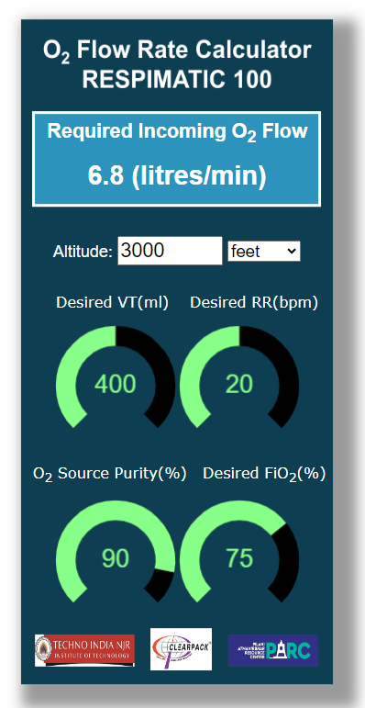
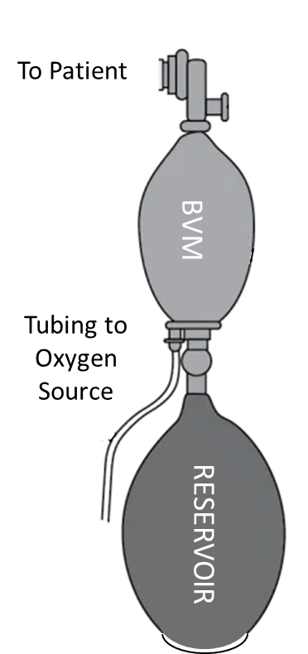
FiO₂ Settings
Without the Reservoir bag, FiO₂ delivered is the Atmospheric O₂ content at site
FiO₂ delivery with the Reservoir bag is mathematically modelled, calibrated and verified in the Lab to provide +/- 5% accuracy
Front-panel guides the user in setting the appropriate input O₂ flow rate from the O₂ source for a given FiO₂
The mathematical model provides for a possible O₂ concentrator as an O₂ source (purity < 100%)
Online Web-accessible FiO₂ calculator is also provided for exploration purposes

Slide 27
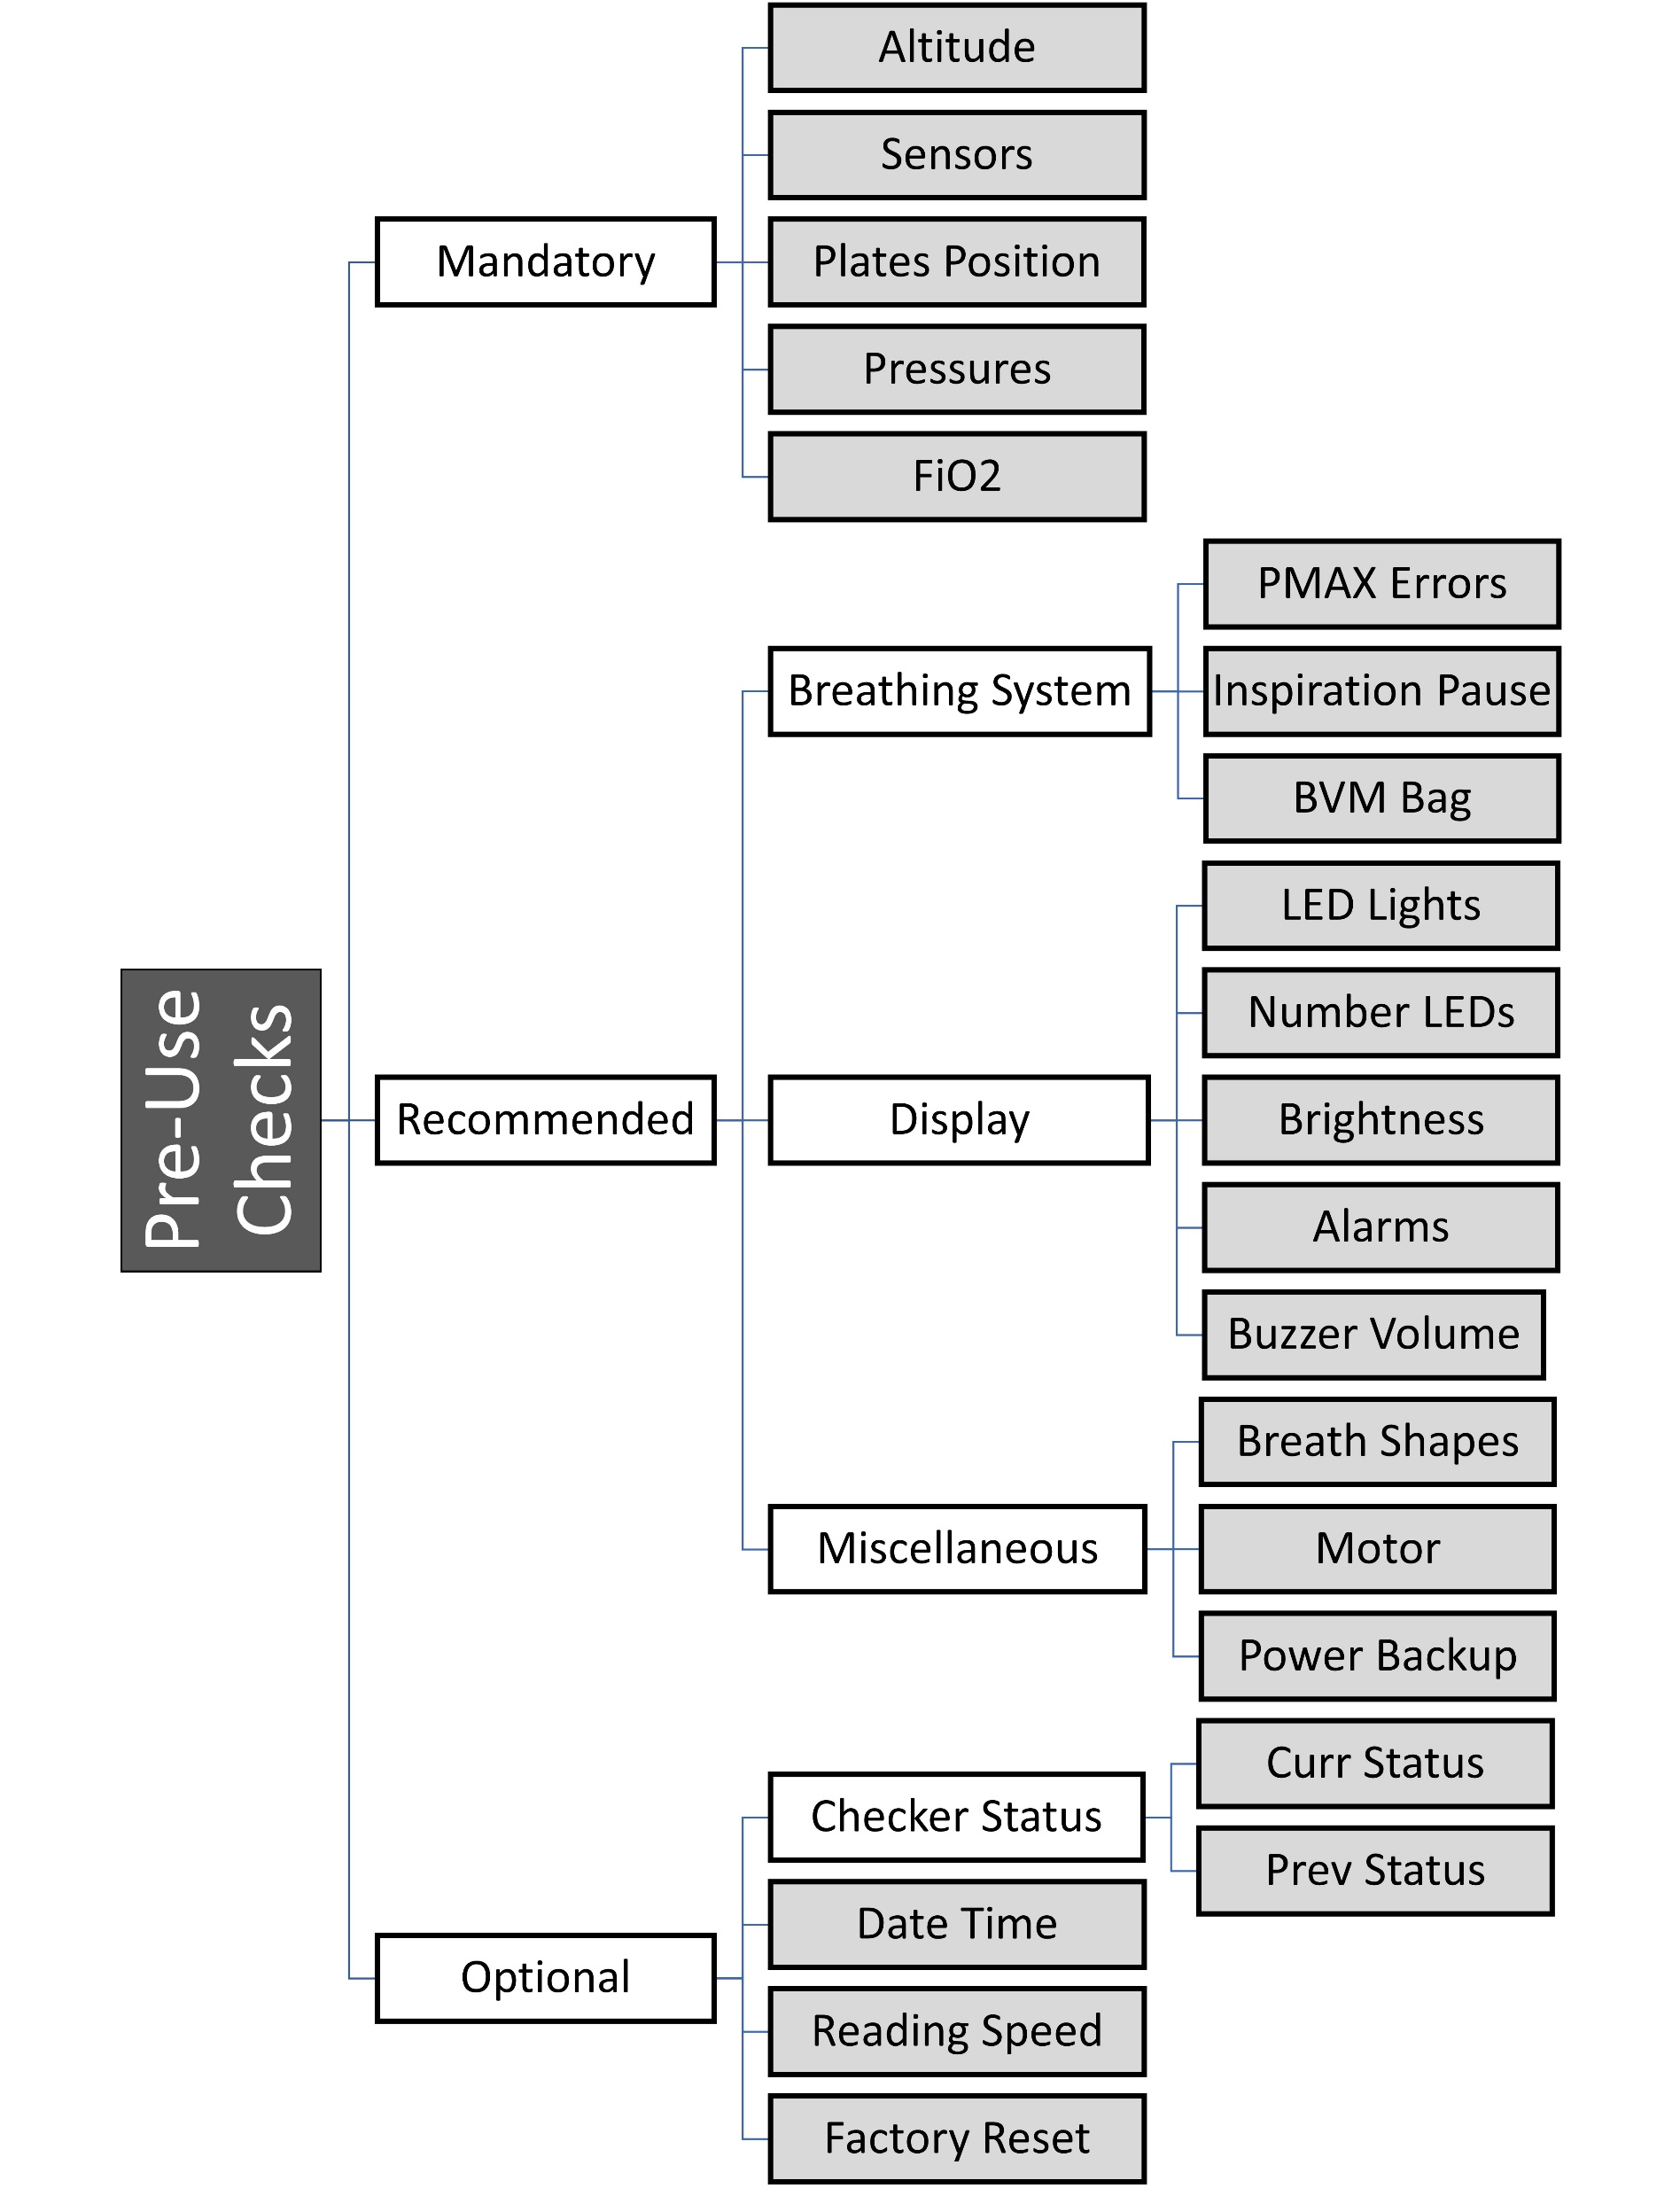
Alarms and Safety Features
Enforcement of Pre-use checks
Alarms, Warnings and Notifications
Maintenance Breaths till Alarm situation rectified
Max Pressure Alarm
Pressure Loss Alarm
System Temperature Alarm
Sensor failure Alarm
Breathing Circuit Failure Alarm
Detect coughing/hiccuping fits
Inconsistent input parameters
And many more …

Slide 28
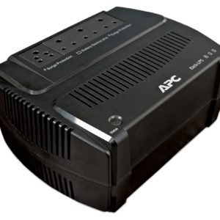
Power Consumption
An online, sine-wave, external battery UPS recommended to continue operation during power outages
50 AH Car battery is sufficient to run the system for 5+ hours
100 AH Tubular battery is sufficient to run the system for 10+ hours
Input Voltage | 180-250 V
Power Consumption | < 100 Watts

Slide 29
Respimatic Testing Process Timing, Flow and Pressure Checks for all combinations of various settings
Automated Testing for all combinations of VT, RR, IE, PEEP, PS with randomized spontaneous breath triggers
Automated testing of full day runs checked for timing within 1% of theoretical expectations
All testing so far with a simple test lung Next step needs a more sophisticated test lung

Slide 30
Compare & Contrast Various Systems
CPAP | BiPAP | Respimatic-100 | ICU Ventilator
Continuous Positive Airway Pressure | Continuous Bi-Level Airway Positive Pressure | Mechanical Ventilation with 4 frequently used ventilation modes and controls | Mechanical Ventilation with sophisticated ventilation modes and controls
Non-invasive | Non-invasive | Non-invasive | Non-invasive / Invasive
High Flow + PEEP | Inspiratory Pressure + PEEP | VT + PS + PEEP | VT + PS + PEEP
Useful for Type 1 respiratory Failure (Hypoxemic) | Useful for Type 2 respiratory Failure (Hypercopnic) | Useful for Type 1 and Type 2 respiratory Failure | Useful for Type 1 and Type 2 respiratory Failure
Continuous flow at a constant pressure. Increases mean airway pressure to recruit collapsed alveoli. | Continuous flow at a constant pressure during inspiration and a different constant pressure during expiration | Independent control over the volume, the respiration rate and the pressure as required. | Independent control over the volume, the respiration rate and the pressure as required.
Useful only when patient can breathe on their own | Useful only when patient can breathe on their own | Useful when patient can or cannot breathe on their own | Useful when patient can or cannot breathe on their own
Only Spontaneous breaths that are patient triggered. | Only Spontaneous breaths that are patient triggered. | Spontaneous breaths PLUS Mandatory breaths controlled by RR and I:E | Spontaneous breaths PLUS Mandatory breaths controlled by RR and I:E
External FiO2 control | External FiO2 control | External FiO2 control | Direct Internal FiO2 control
Breath Syncing N/A | Breath Syncing N/A | Full Breath Syncing | Full Breath Syncing
No VT control | Indirect VT control (IPAP-EPAP) | Direct VT control | Direct VT control
No RR control | No RR control | Direct RR control | Direct RR control
No I:E control | No I:E control | Direct I:E control | Direct I:E control
External Humidity control | External Humidity control | External Humidity control | Direct Humidity control
No monitoring of Peak, Plateau or PEEP pressures | No monitoring of Peak, Plateau or PEEP pressures | Direct monitoring of Peak, Plateau and PEEP pressures | Direct monitoring of Peak, Plateau and PEEP pressures
Minimal alarm signals | Minimal alarm signals | Full set of Alarm signals | Full set of Alarm signals

Slide 31
Thank you

Slide 32
Backup
Market Analysis
Sample Waveforms

Slide 33
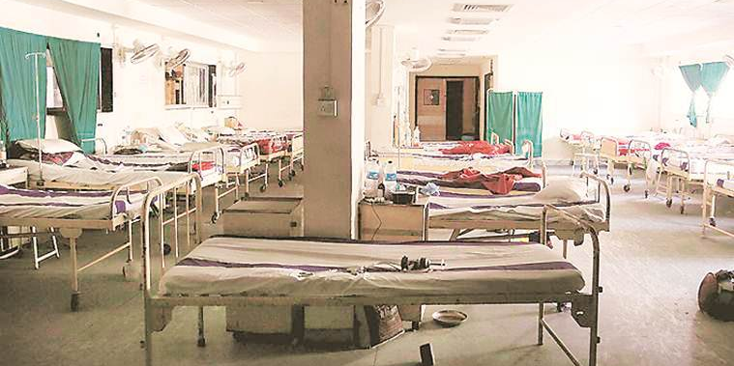
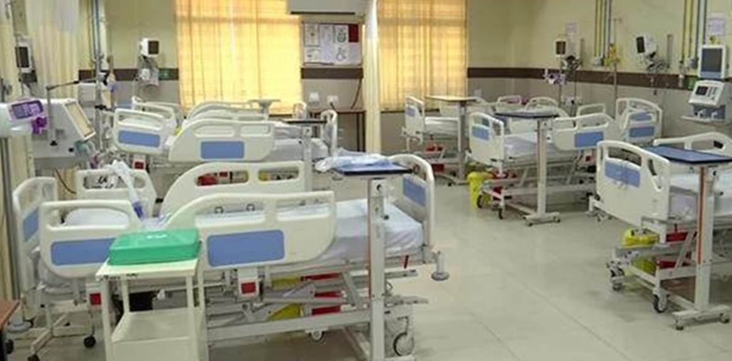
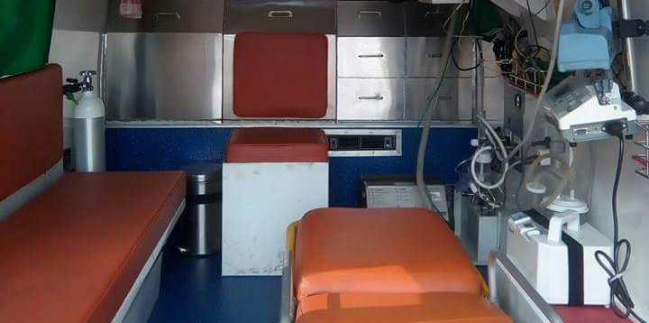
The Problem
Scarcity & Affordability
India has amongst the lowest per capita ICU beds in the World*
1.46 beds / 1000 people*
3.65 ICU beds / Lakh people*
Only half of ICU beds are equipped with Ventilators
A meagre 1.8 Ventilators for one lakh people*
ICU ventilators are expensive equipment
Unaffordable in remote clinics
Ventilator Ambulances are
Either non-existent except in few major urban centres,
Or beyond the reach of majority of population
* As per April 2020 Study by Center for Disease Dynamics, Economics & Policy at Princeton University, USA

Slide 34
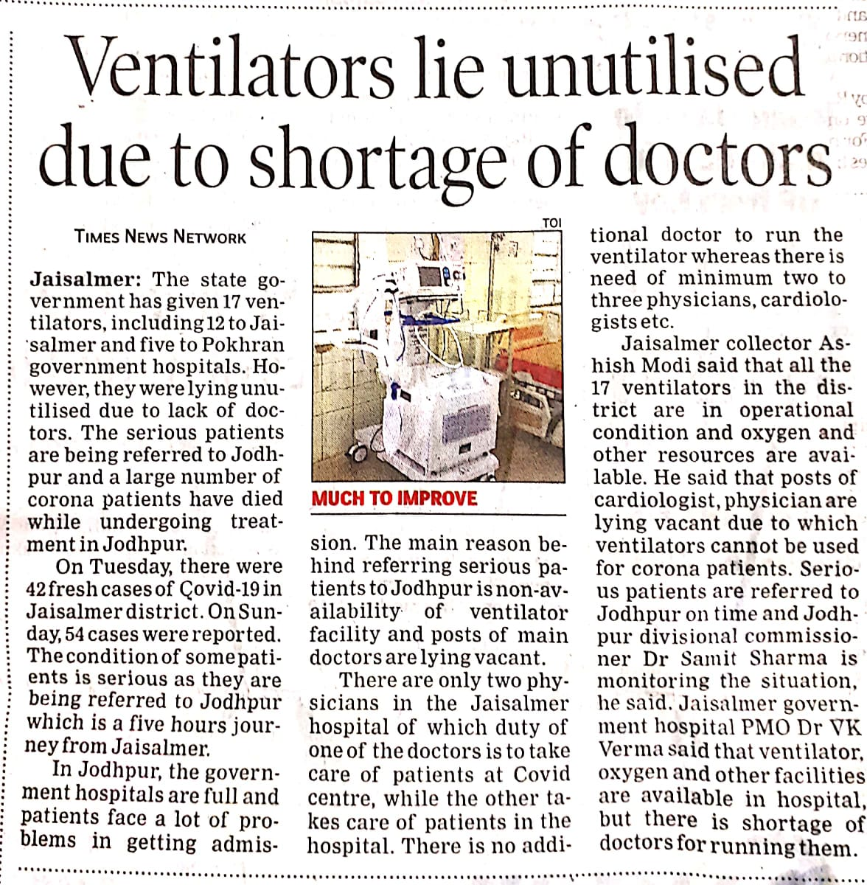
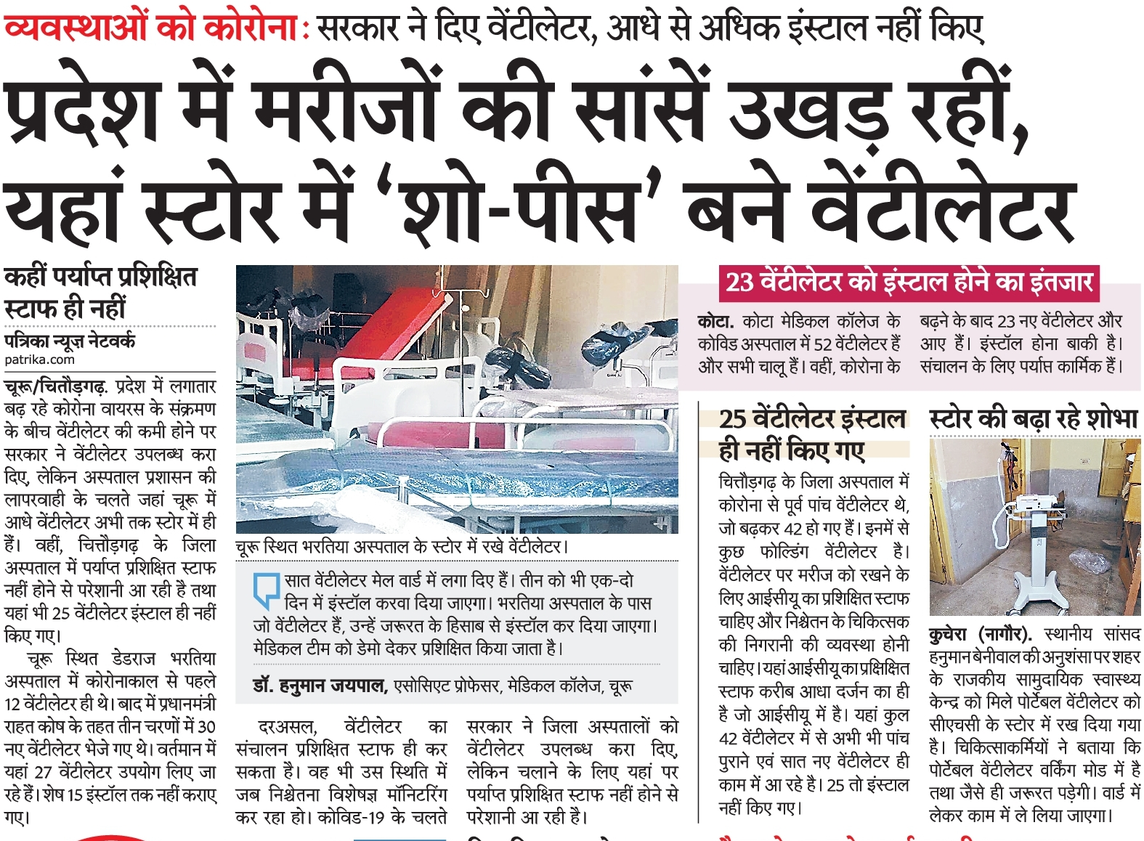
The Problem
Skilled Practitioners
ICU Ventilators require highly skilled manpower to operate and monitor

Slide 35
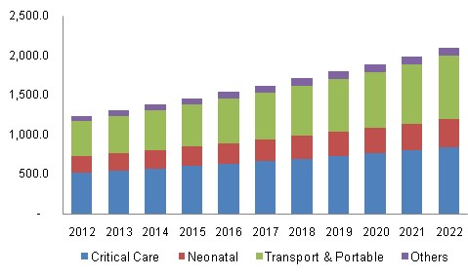
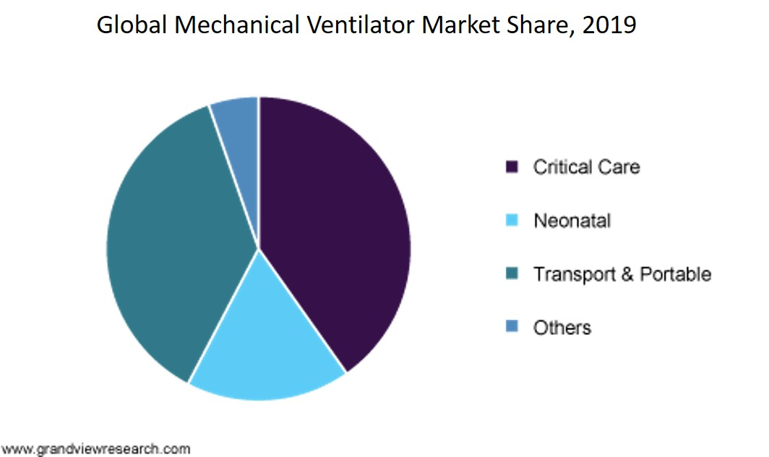
Market Need
25 to 50 ventilators per lakh people in developed countries
1.8 ventilators per lakh people* (India)
Even less for lower income developing and underdeveloped countries*
* As per April 2020 Study by Center for Disease Dynamics, Economics & Policy at Princeton University, USA

Slide 36
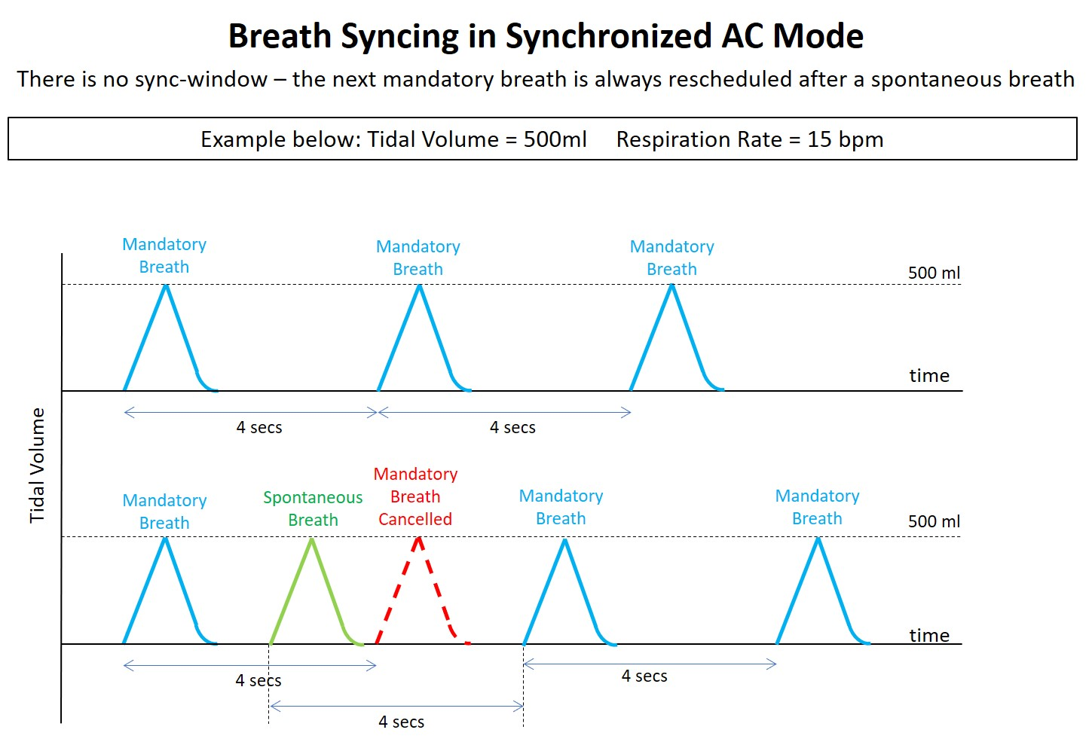
Breath Synchronization in ACV Mode
Tidal volume is delivered at regular intervals T_{i}.
If spontaneous breath occurs during this interval at time T_{s}, the set tidal volume is delivered in response, and the next mandatory breath is set for (T_{s}+ T_{i}).
Again, if another spontaneous breath is detected before T_{s} + T_{i}, a mandatory breath scheduled T_{i} time in future.

Slide 37
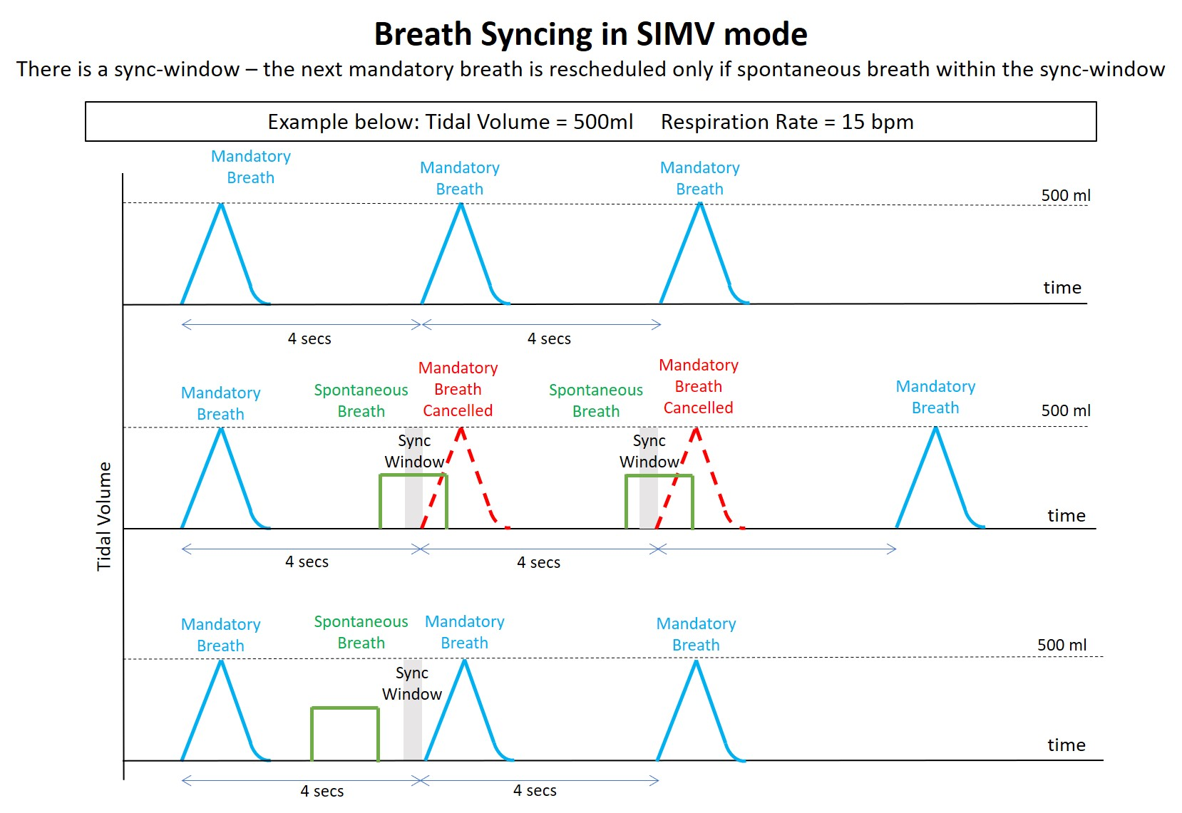
Breath Synchronization in SIMV Mode
Tidal volume is delivered at regular intervals T_{i}.
If spontaneous breath occurs during this interval at time T_{s}, a pressure supported breath is delivered in response, and the next mandatory breath is set for (T_{s} + 0.9 T_{i}).
This is to allow more spontaneous breaths but to trigger a mandatory VC breath if spontaneous breath is not detected within 90% of the mandatory breath interval.

Slide 38
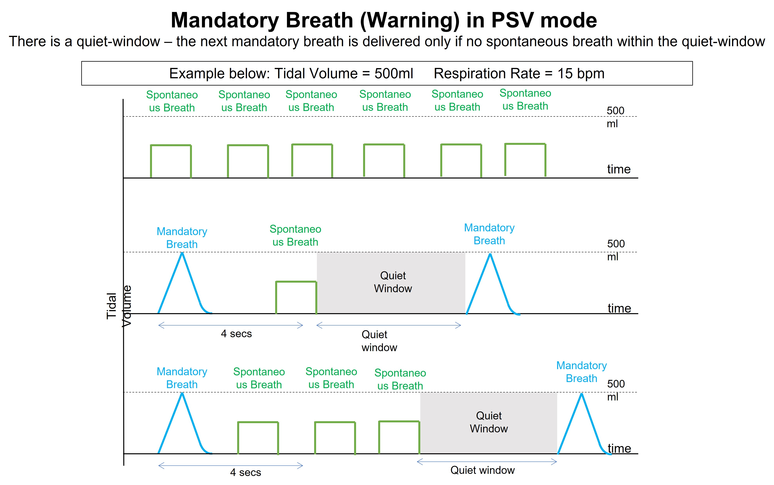
Exceptional Mandatory Breath in PSV Mode
Tidal volume is delivered at regular intervals T_{i}.
If spontaneous breath occurs during this interval at time T_{s}, a pressure supported breath is delivered in response.
This avoids breath stacking issues.
The next mandatory VC breath is not delayed at all unless it is too close to the spontaneous breath (within 20% of T_{i}).

